Slide 1
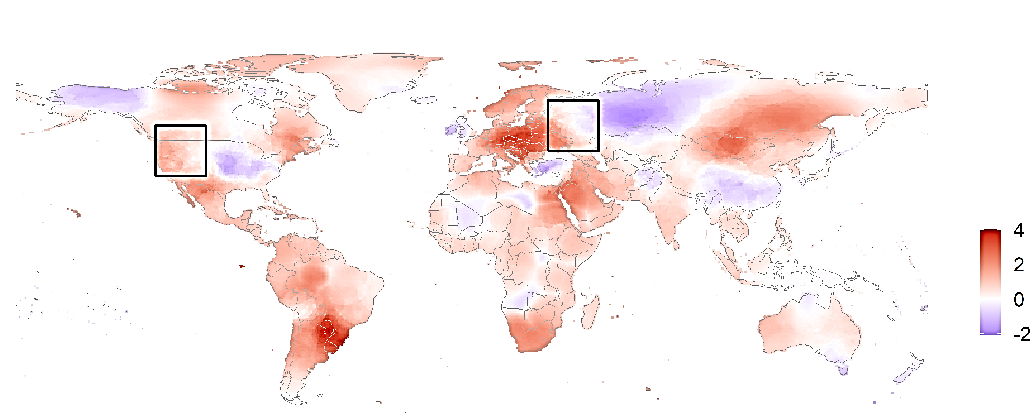
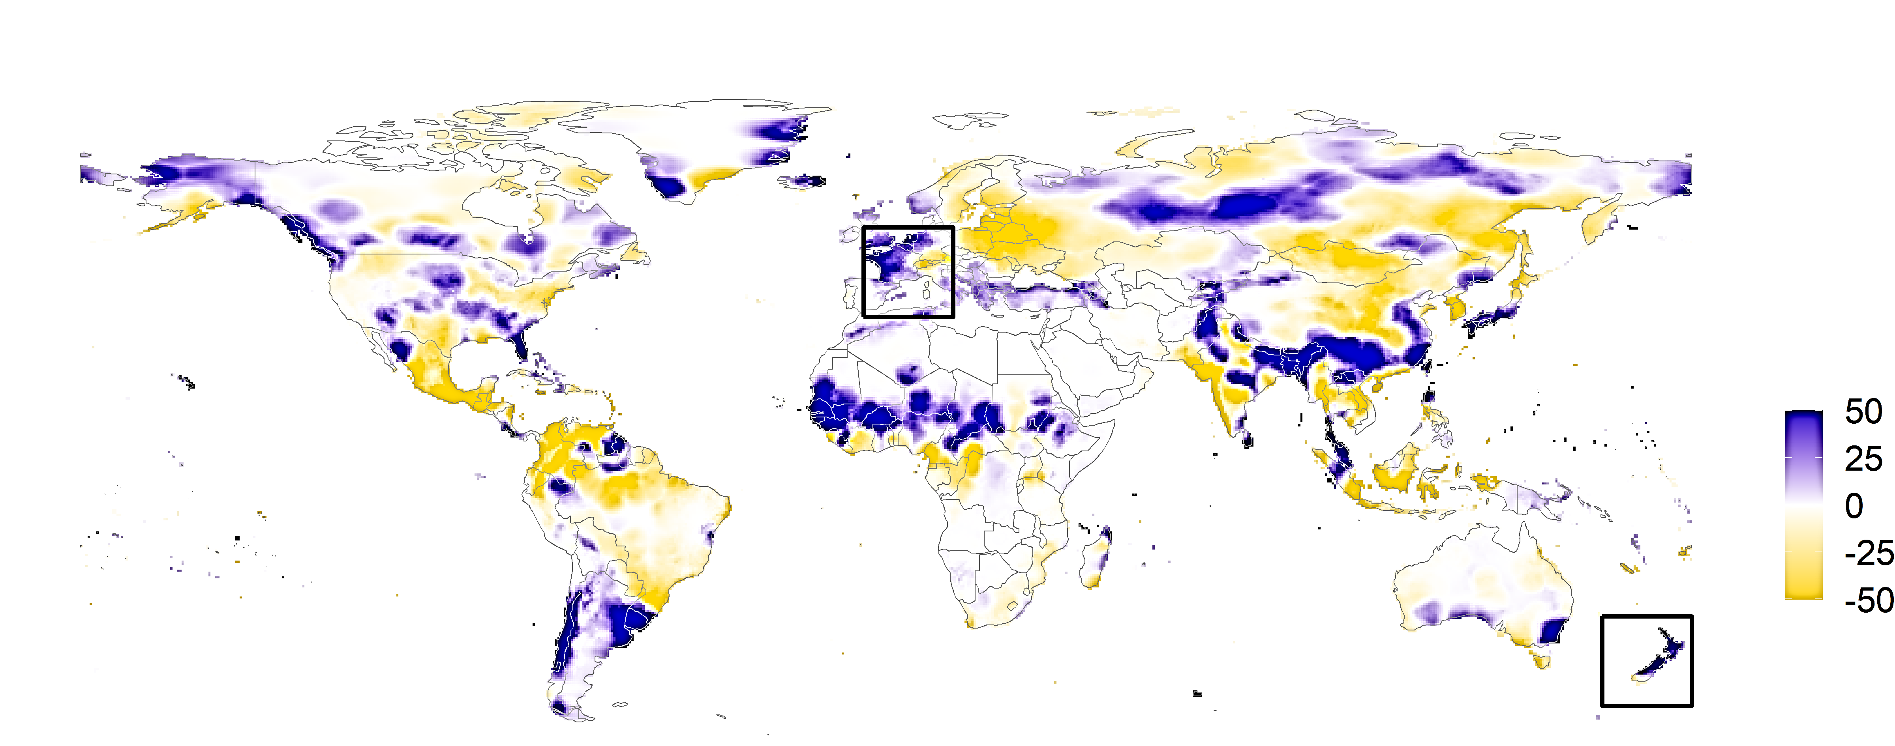
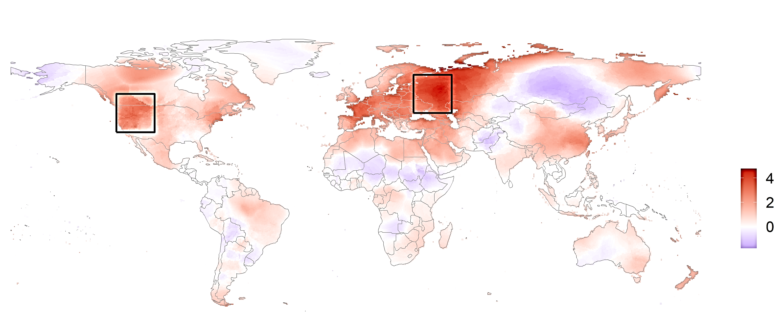
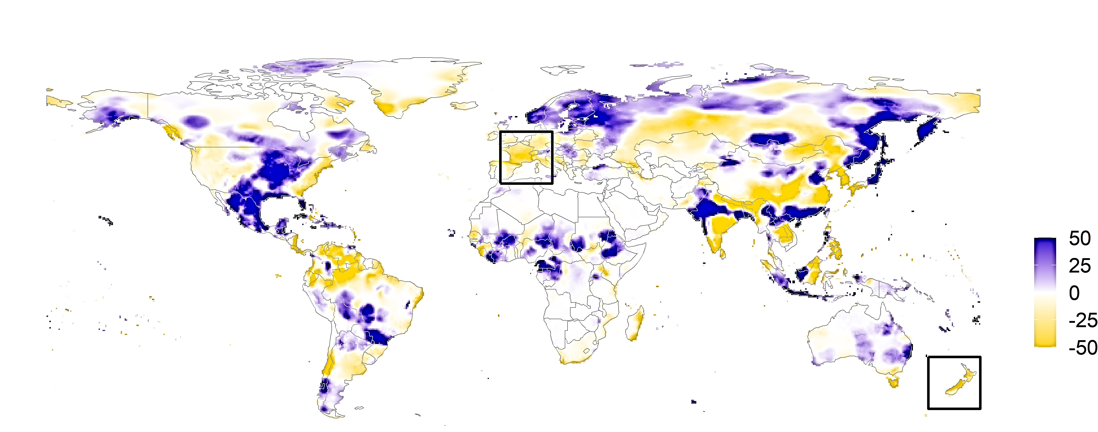
Temperature Anomalies
Precipitation Anomalies
A)
2015 Reference Period
B)
2015 Reference Period
Region 2
Region 1
Region 3
Region 4
C)
2022 Sigma event
D)
2016 Sigma event
+2.4ºC
+3.9ºC
-22 mm
-45 mm

